Slide 1
Season Ticket Defectors
By: Kinsey Keltz

Slide 2
Introduction & Project Description
Given data from last football season, analyze the data to figure out which season ticket holders are likely to defect and why.

Slide 3
Key Findings
The longer the ticket holder has had the tickets the less likely they are to defect
The more games the ticket holder went to last season the less likely they are to defect
The higher income the ticket holder has the less likely they are to defect

Slide 4
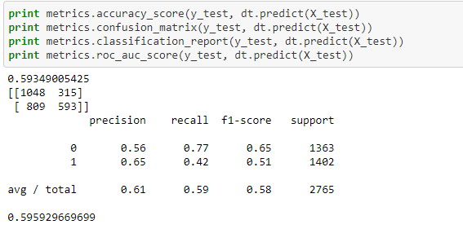
Best Model

Slide 5
Who will renew?
The ticket holders who will renew are the ones who went to 3 or more games, have had tickets for more than 2 years or who have income greater than 4.

Slide 6
Who will likely defect?
Ticket holders who are likely to defect have only had season tickets for less than 2 years, went to less than 3 games, and who’s income is less than 3.

Slide 7
Actions to Take
Call all of the ticket holders likely to defect and sell them on renewing.

Slide 8
Additional Variables
To make more of an educated guess it would have been nice to have the information of where people were living as well as if they were K-State Alumni or not.

Slide 9
Conclusion
Ticket holders who have not had tickets for very long, do not have a large income or do not travel to the games are not likely to renew.

